Slide 1
Predict the number of shared bikes by weather conditions
Group Member:
Zichu Chen, Ziya Zhao, Kaiqi Yu

Slide 2
Outline
Introduction of data
EDA
Model & Evaluation

Slide 3




Why is the study important?
Bike sharing
Weather
Holiday&weekend
Registered
Notes:
Bike sharing systems are a new generation of traditional bike rentals where the whole process from membership, rental and return back has become automatic.
Through these systems, user is able to easily rent a bike from a particular position and return back to another position. Currently, there are about over 500 bike-sharing programs around the world which are composed of over 500 thousands bicycles. Today, there exists great interest in these systems due to their important role in traffic, environmental and health issues.
Apart from interesting real-world applications of bike sharing systems, the characteristics of data being generated by these systems make them attractive for the research. Opposed to other transport services such as bus or subway, the duration of travel, departure and arrival position is explicitly recorded in these systems. This feature turns bike sharing system into a virtual sensor network that can be used for sensing mobility in the city. Hence, it is expected that most of important events in the city could be detected via monitoring these data.

Slide 4
Smart Question
How many users would use a sharing bike in a specific hour?

Slide 5
Data resource
2011-2012 Bike Sharing in Washington D.C. Dataset from Kaggle
2017 Bike Sharing in Washington D.C Dataset from capital bikeshare
2017 Daily Observations of Arlington County, VA Weather History from weather underground
Notes:
(https://www.kaggle.com/marklvl/bike-sharing-dataset#hour.csv)
This dataset contains the hourly and daily count of rental bikes between years 2011 and 2012 in Capital bikeshare system in Washington, DC with the corresponding weather and seasonal information.
(https://s3.amazonaws.com/capitalbikeshare-data/index.html)
https://www.wunderground.com/history/daily/us/va/arlington-county/KDCA/date/2017-1-1

Slide 6
Data description
1. 2011-2012 bike sharing data from Kaggle
17379 rows
From 2011.1.1 to 2012.12.31
A record for each hour
Columns : time, temperature, humidity, windspeed, casual or register, count of used sharing bike

Slide 7
Data description
2. 2017 Bike Sharing in Washington D.C Dataset from capital bikeshare
8738 rows
From 2017.1.1 to 2017.12.31
A record for each bike renting

Slide 8
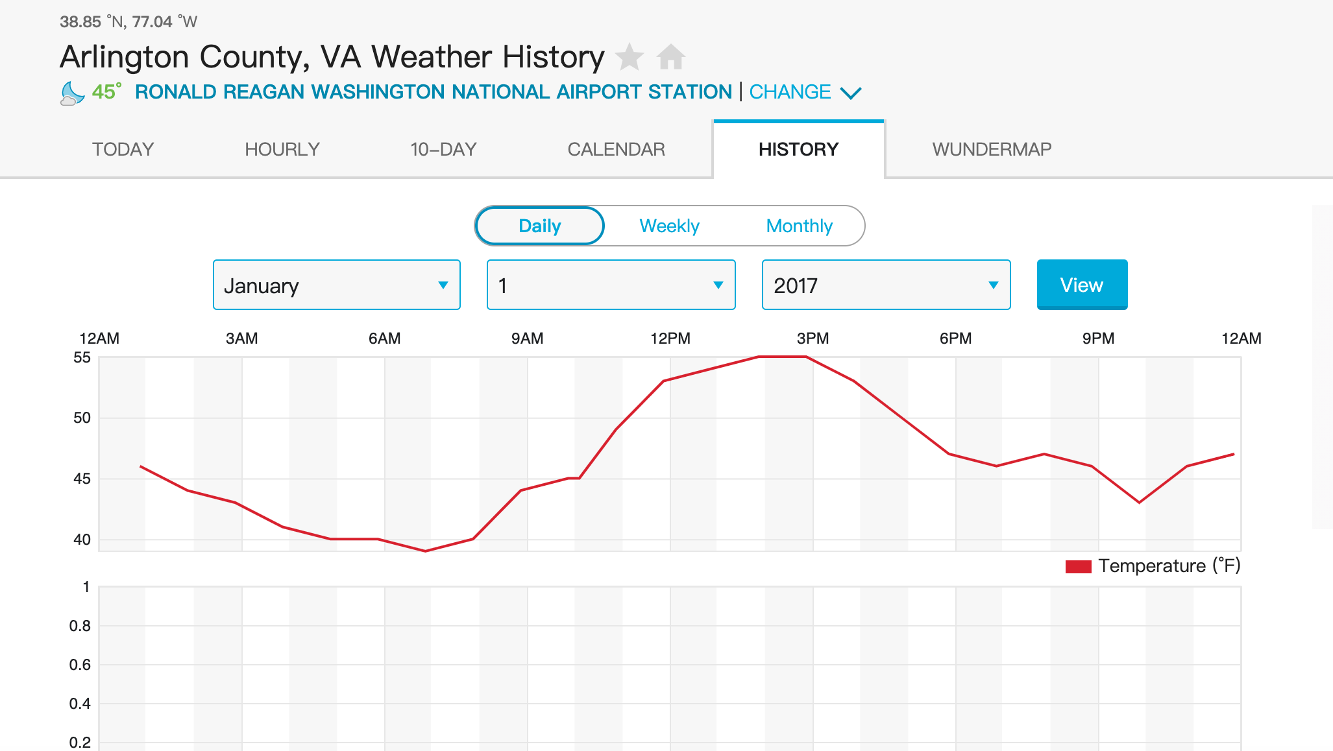
Data description
3. 2017 Daily Observations of Arlington County, VA Weather History scraped from weather underground

Slide 9
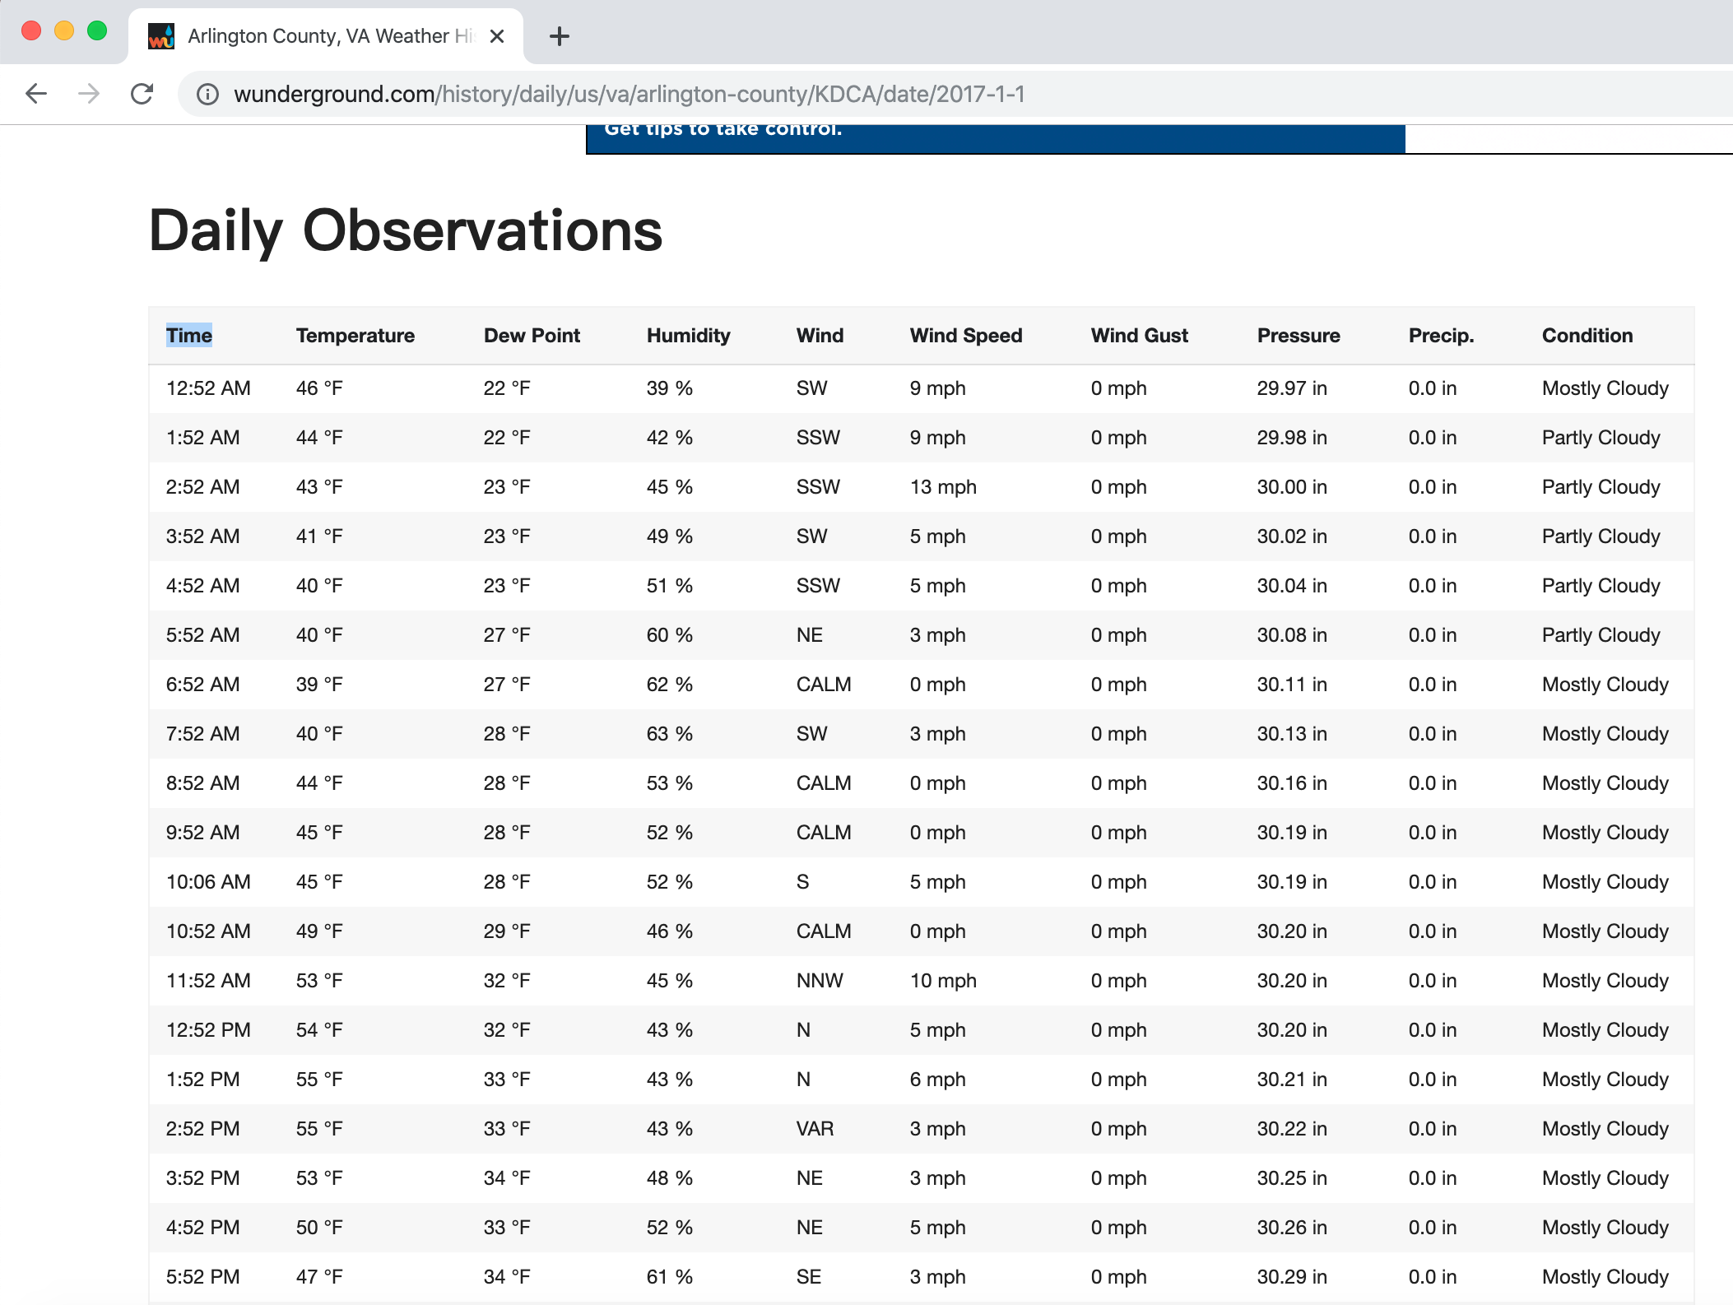
Web scraping& Data cleaning

Slide 10

Web scraping& Data cleaning
+
=
2017 sharing
bike records
2017 weather records
2017 bike dataset

Slide 11
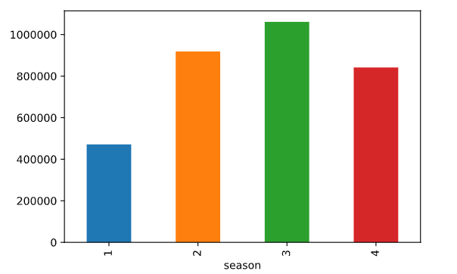
Count vs Season
Notes:
First we observe the effect of seasonal changes on the number of people using bike sharing.
As shown in the figure, most people using shared bicycles in autumn, followed by summer, winter, and spring.

Slide 12
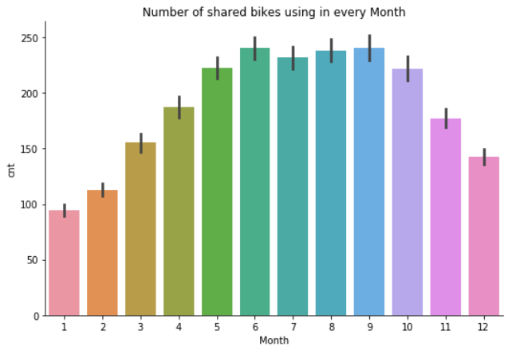
Count vs Month
Notes:
Next, we analyzed the impact of the month on the number of users, and found that the peak period of bicycle sharing is concentrated in June to September

Slide 13
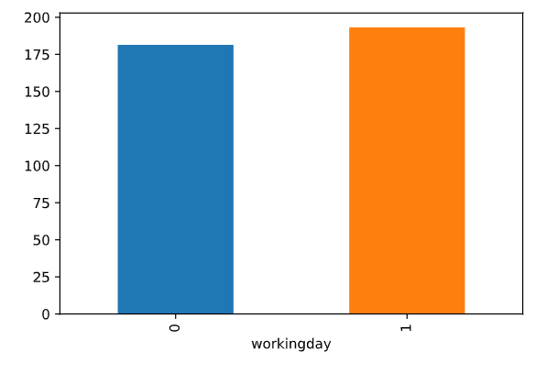
Count vs Workingday
Notes:
When investigating usage on workingdays, we calculate their averages separately. It was found that nearly 200 people use bicycles per hour on workingdays and almost 175 people use sharing bicycles per hour on holidays.

Slide 14
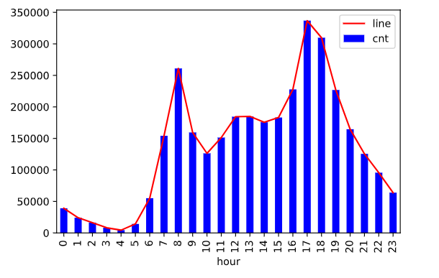
Count vs Hour
Notes:
Next, we researched the usage of each hour and found that the peak hours at 8am and 5-6pm during the day.

Slide 15
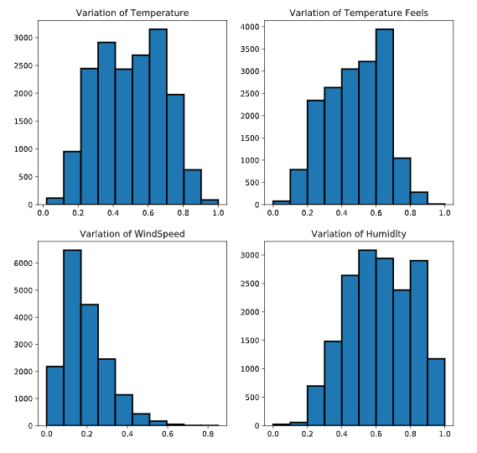
Count vs Condition
Notes:
After comprehensively comparing the analysis results of weather conditions, we can conclude that the most people use bicycle sharing when the temperature is high, the more people use it when the wind speed is low, and the most people use it when the humidity is high. But when these factors reach extreme values, the number of sharing bicycles people used is the least.

Slide 16
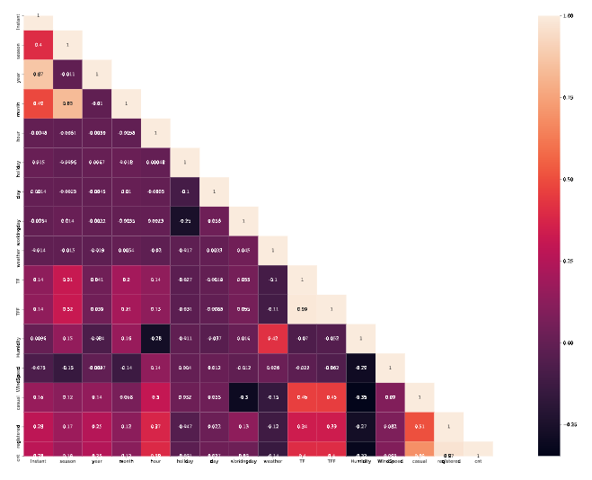
Correlation Matrix
Notes:
We use corelation matrix to decide which features on the weather website need to be crawled.

Slide 17
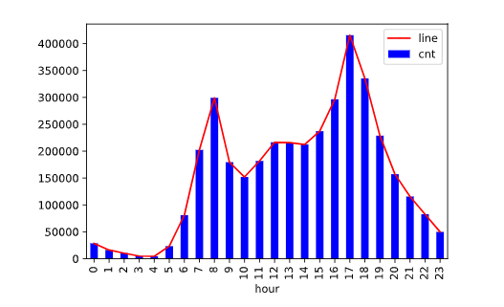
COUNT vs HOUR
Notes:
Through the analysis of the new data, we find that the use of shared bicycles at the hour level is very similar. Peak hours are 8 am and 6 pm.

Slide 18
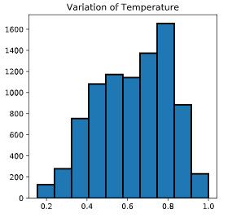
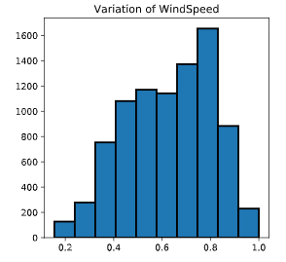
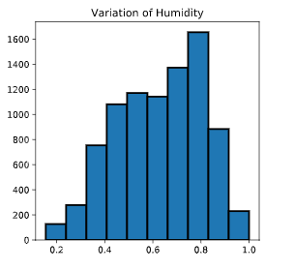
COUNT vs CONDITION
Notes:
In the 17-year record, the impact of weather conditions on the use of shared bicycles has not changed much. Compared with the changes in 10-11 years, people will use shared bicycles more when the wind speed is moderate.

Slide 19
Regression Model
Because the data type of our analysis target is continues, we will use two different regression models to see how well the prediction of our 2017 data fit with the original data from 2011 to 2012.
Linear regression model
Regression tree model

Slide 20
Linear regression model
Data processing method:
For un-continues variables, we use dummy functions to separate them for further regression analysis.
After an analysis of our variable, we decide to get rid of some variables because they do not have significant effect in the model summary
Also we separate our data into test and train for better prediction

Slide 21
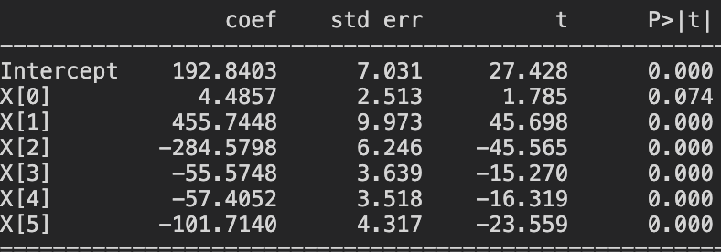
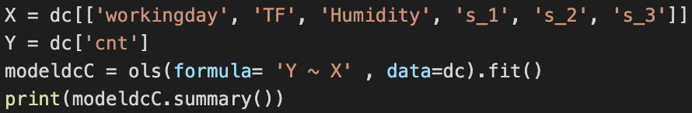
Linear regression model
Result:

Slide 22
Linear regression model
Result:
After several try-out of different X combinations with correspondent Y. The following are the observations of the linear regression analysis:
More users rent bike on workingday, less cnt users rent bike on holiday and more people will rent bike when humidity is low and temperatue is high

Slide 23
Regression Tree Model
Data processing method:
Because we have analyzed our data using Linear regression, we have a better understanding of our data(what variable will be used for further study), the X and Y variable will be same as Linear regression model
And we will use Root Mean Square Error (RMSE) to mesaure how well the modle fit

Slide 24
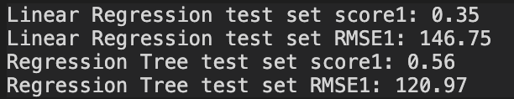
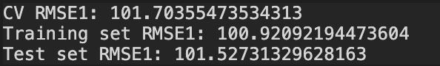
Comparison
Result:
The unit of RMSE is same as dependent variable. If your data has a range of 0 to 100000 then RMSE value of 3000 is small, but if the range goes from 0 to 1, it is pretty huge.
Also, we have the comparison of RMSE of both test and train datasets. The result is below, since our RMSE of test data is quite simillar to train dataset. The model we have is good.

Slide 25
Prediction
After we did the web scrap for the weather data in 2017, we will use the data 2017 as the test group and the original dc data as the train to see how well we can fit with the model we make using ‘Temprature', 'Humidity’, and 'WindSpeed'

Slide 26
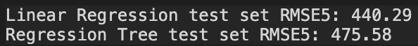
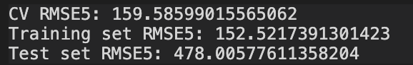
Prediction
Result:
We can see from the result that if we are going to use the web scrap data, the better model would be linear regression instead of the regression tree
The reason because of that is because of the result showing below:
RMSE of test > RMSE of train => OVER FITTING of the data.

Slide 27
Thank you!

